Slide 1
Welcome to all
for the Advertising Online lecture
By
Dr. Dhiraj Ovhal
HOD of Commerce

Slide 2
Evolution of Advertising
1.Early form of Advertising
Trade Marks:- In olden days Artisans used to inscribe on the goods such as pots, wooden tools, etc. certain marks such as starts, moon, sun, tiger, etc.
Spread information due to the word of mouth and purchased that trade mark for trading
Town Criers:- Prior to 15 Century – Shopkeepers and other sellers had- Wore Clony cloths and played musical instruments flute or drum
Sign boards :- from last 5000 years -- In olden seller used to paint sign on rocks or board about

Slide 3
2. Birth of Printing Press: In 1438. Johan Gutenberg invented the crude form of printing press. This made possible the printed advertisements in following forms:
(a) Handbills: In 1477, William Caxton from London brou
out the first ever printed advertisement in the form of handbill. The advertisement was for a religious book.
(b) Newspaper Advertising: The Gutenberg's invention made
possible the printing of a newspaper. The first newspaper came into existence in Germany around 1520, and the first newspaper ad was published in about 1525 in Germany for a book.
The first printed English newspaper appeared in 1622 called "The Weekly News of London", and the first ad in an English newspaper appeared in 1625 for a book.
(c) Magazine Advertising: Magazines were first published in
the early 1700s. However, advertising in magazines gained recognition only around 1870. In those days, most of the advertisements were in the form of posters/handbills and in newspapers.

Slide 4
3. Birth of Advertising Agency:
The first acknowledged ad agency was set up by William Taylor in 1786 in England. In 1850 Volney B. Palmer started the first American advertising agency in Philadelphia. In those days, ad agencies used to act as "salesmen of space”. They used to sell space in newspapers and magazines on behalf of publishers to the advertisers. They used to get 25% commission for such services. The real advertising work such as copywriting, art-work etc., by the ad agencies began in the early 20th century.In 1877, James Walter Thompson took over an ad agency (from William James Carlton) and renamed as James Walter Thompson (JWT) Company. It is the oldest ad agency and server today also.

Slide 5
4. Radio Advertising:
Marconi invented the radio around 1900. The radio was introduced to the public in the early 1920s. WEAF of New York is credited with airing the first paid radio commercial, on August 20, 1921, for the Queensboro Corporation, advertising an apartment complex - "Hawthorne Court Apartments in Jackson Heights" in USA.
Because of the invention of radio, it was made possible to advertise to the illiterates. The music and sound effects of radio advertising gave a new meaning to the field of advertising.
5. Television Advertising: In 1930s John L. Baird invented the commercially viable television. It was the most impressive medium of all times. The television advertising combined the effect of voice and vision, music and motion. The first TV commercial appeared in USA on 1st July 1941 for Bulova Watches.

Slide 6
6. Other forms:- In the 20th century several other forms of advertising came into existence. It includes neon signs, video, sky writing, billboards. yellow pages, direct mail, etc
7. Growth of Advertising Organisations:
Several advertising organisations came into existence during the 20th century. These include Audit Bureau of Circulation (ABC) in 1914 in America and later on in other countries including India in 1948. Advertising agencies associations were also formed in major countries of the world which include Advertising Agencies Association of America (AAAA) in 1917 and Advertising Agencies Association of India in 1945. Also, in India, the Advertising Standards Council of India was set in 1985. The advertising associations or gave an added impetus to the progress of advertising throughout the world.

Slide 7
8. Internet: An interesting form of advertising in the late 1990s is the internet. Internet can be called as electronic yellow pages. Subscribers to internet open a web site where in they provide information about the company and the products. At present, Internet is the fastest growing medium in the field of advertising. Various forms of internet advertising include:
Website advertising - banners and pop-up ads. Blog advertising. Advertising on social networking sites such as Facebook, Twitter, etc.
•Mobile (internet) advertising, and so on.

Slide 9
Feedback Link
https://forms.gle/U4Da9ykpniL3tpCdA

Slide 10
Thank You

Slide 11
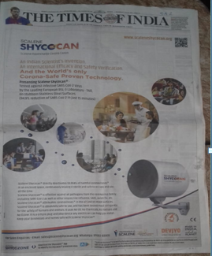

Slide 15
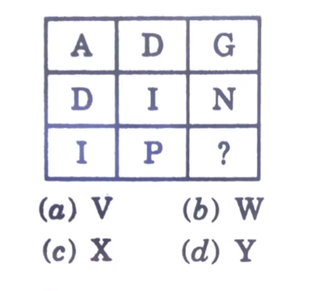

Slide 16
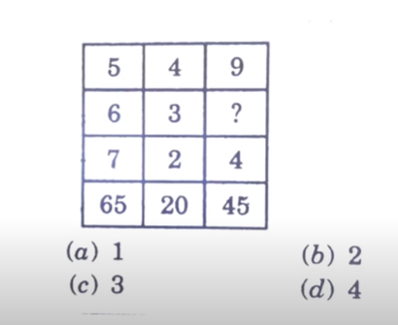

Slide 17
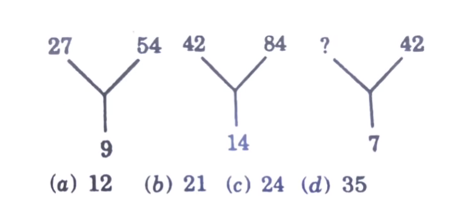

Slide 18
